Slide 1
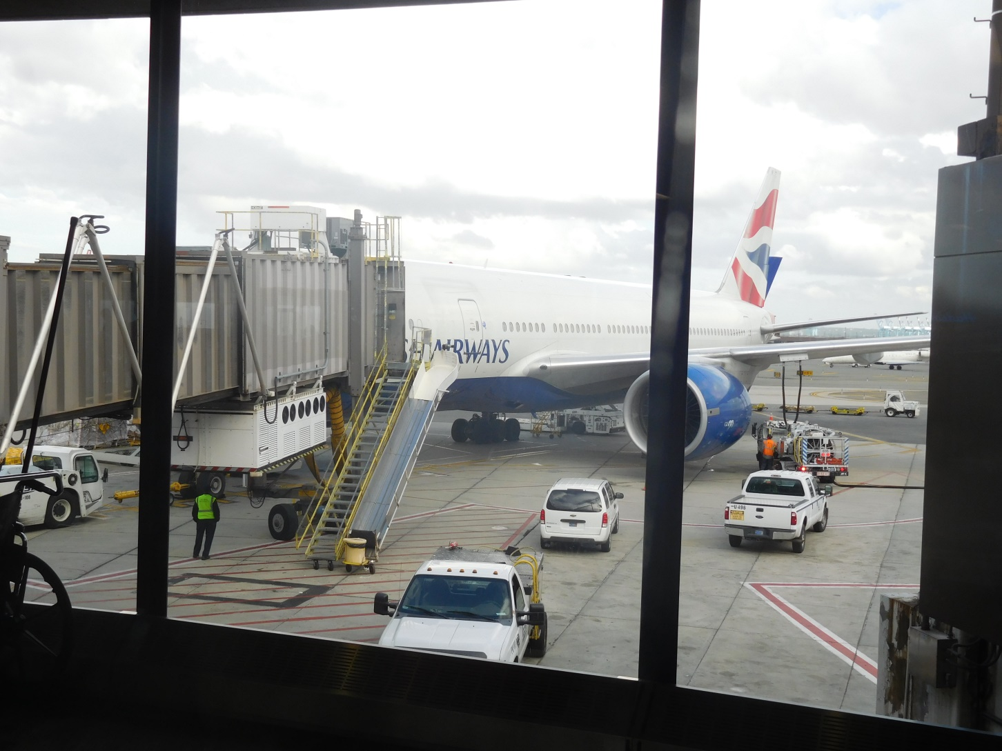
London Trip
May 2017

Slide 2
Conrad London St. James
Notes:
We stayed at the Conrad hotel, across the street from St. James’s Park tube station. It is a 10 minute walk to Buckingham Palace, less than a mile from Westminster Abbey and Big Ben. It is 2 miles from the Victoria and Albert Museum in Hyde Park.

Slide 3
Notes:
“Built at the turn of the 20th Century, Queen Anne’s Chambers was a collection of chambers available for rent for those who needed to be near the seat of power. It was the war-time location for lobbyists and civil servants whose industries were to seriously impacted by the onset of war and goods rationing.”
https://conradhotels3.hilton.com/en/hotels/united-kingdom/conrad-london-st-james-LONCOCI/about/index.html

Slide 4
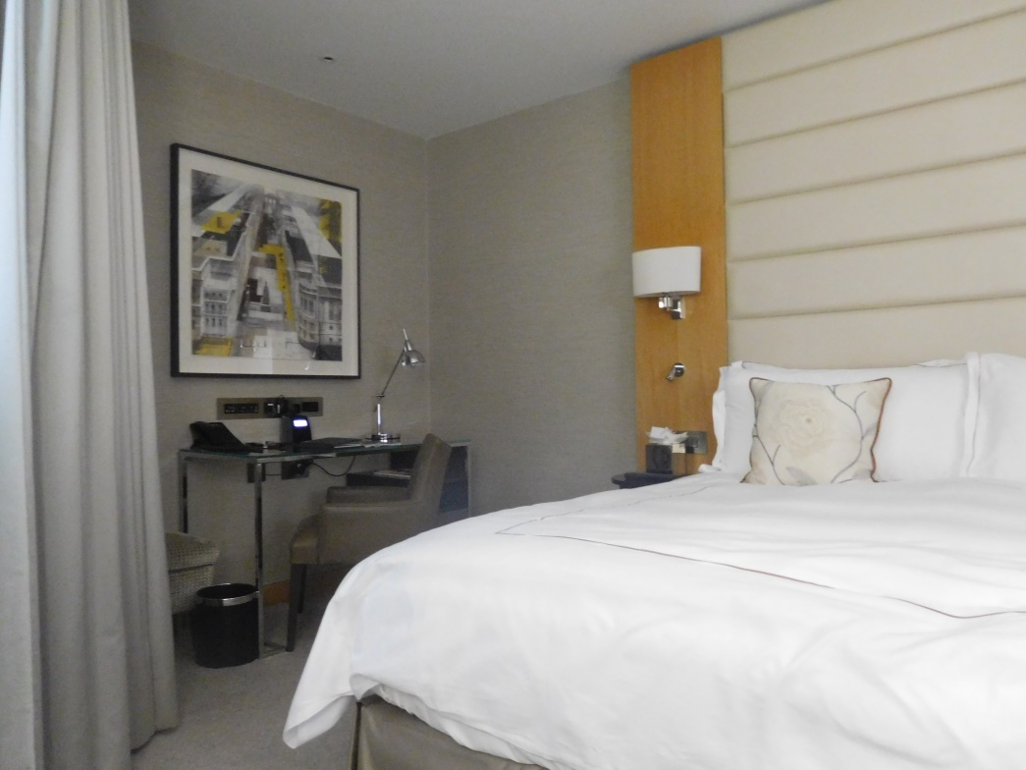

Slide 5
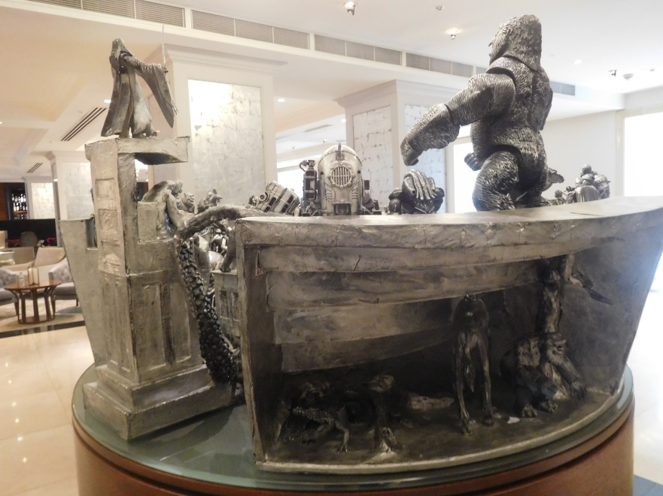
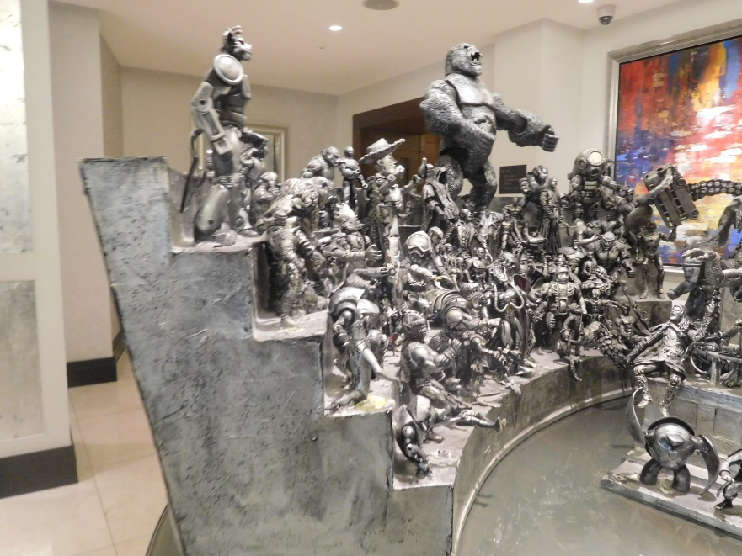
Notes:
Art in the lobby of the hotel

Slide 6
Notes:
After breakfast at the hotel, we walked to St. James Park.

Slide 7
Notes:
On the first day, we checked in, ate breakfast, and then walked to

Slide 8
Horse Guards
Notes:
On the way, we walked past Horse Guards, a historic building that was once the Headquarters of the British Army. It is between Whitehall and Horse Guards Parade, the large area shown in the picture. This parade ground is on the west side of the building facing Horse Guard Road and St James’s Park. Horse Guards was built in the mid-18th century, replacing an earlier building, as a barracks and stable for the Household Cavalry, later becoming an important military headquarters. Horse Guards functions a gatehouse giving access between Whitehall and St James’s Park via gate on the ground floor. It originally formed the entrance to the Palace of Whitehall and later St James’s Palace: for that reason it is still ceremonially defended by the Queen’s Life Guard.
https://en.wikipedia.org/wiki/Horse_Guards_Parade
https://en.wikipedia.org/wiki/Horse_Guards_(building)

Slide 9
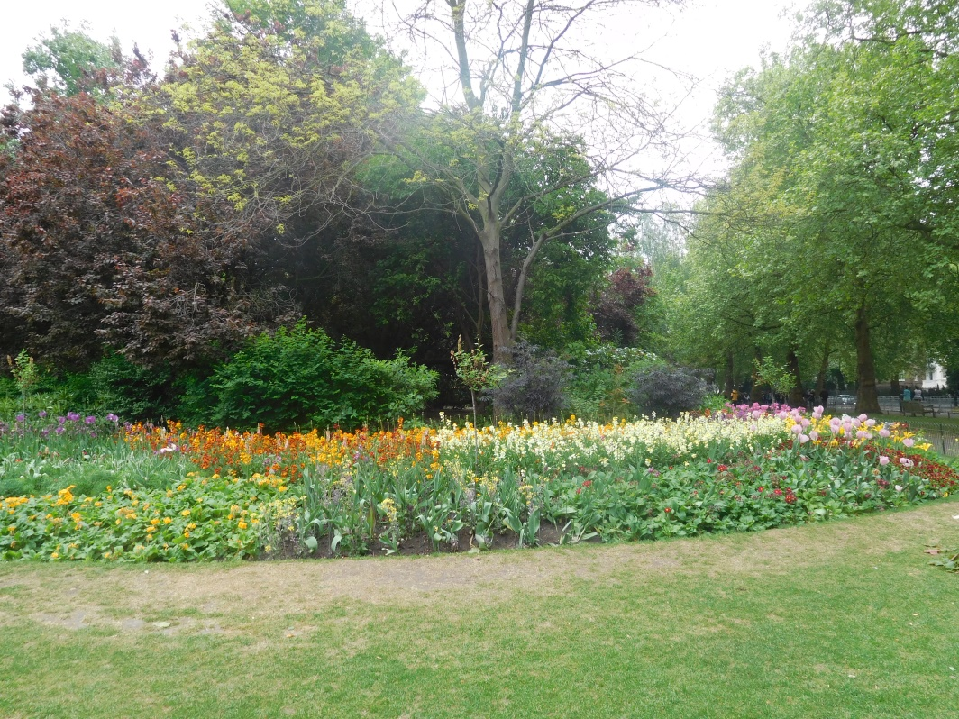
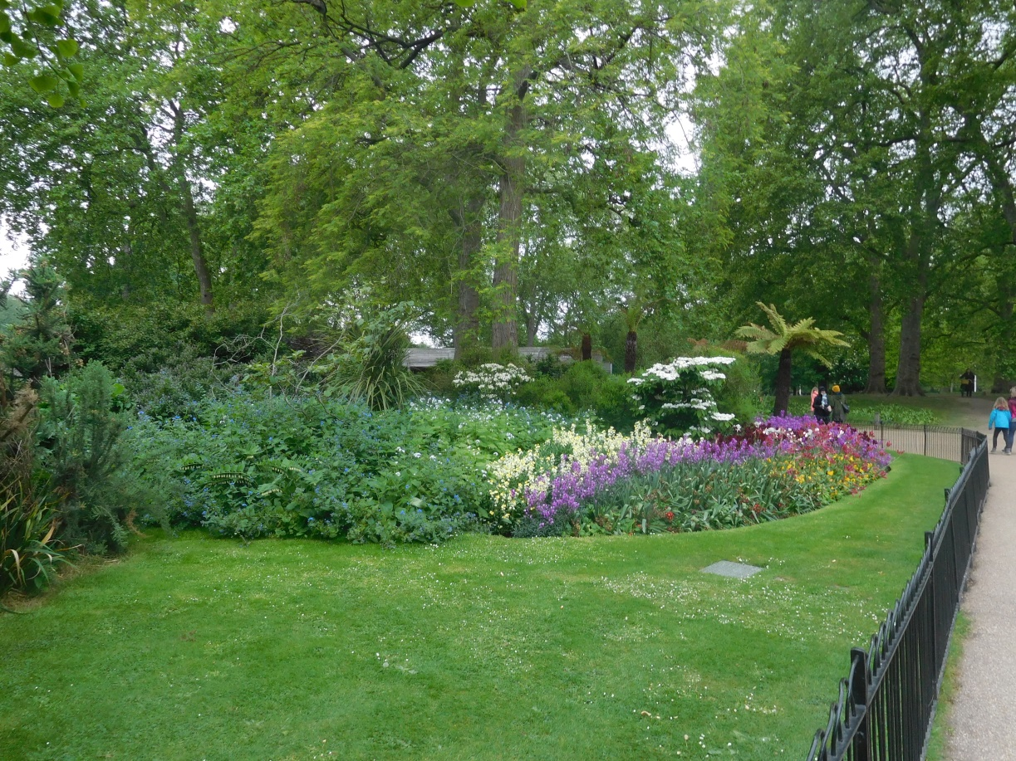
Flower beds in St. James Park
Notes:
We walked in St James Park enjoying the May flowers.

Slide 10
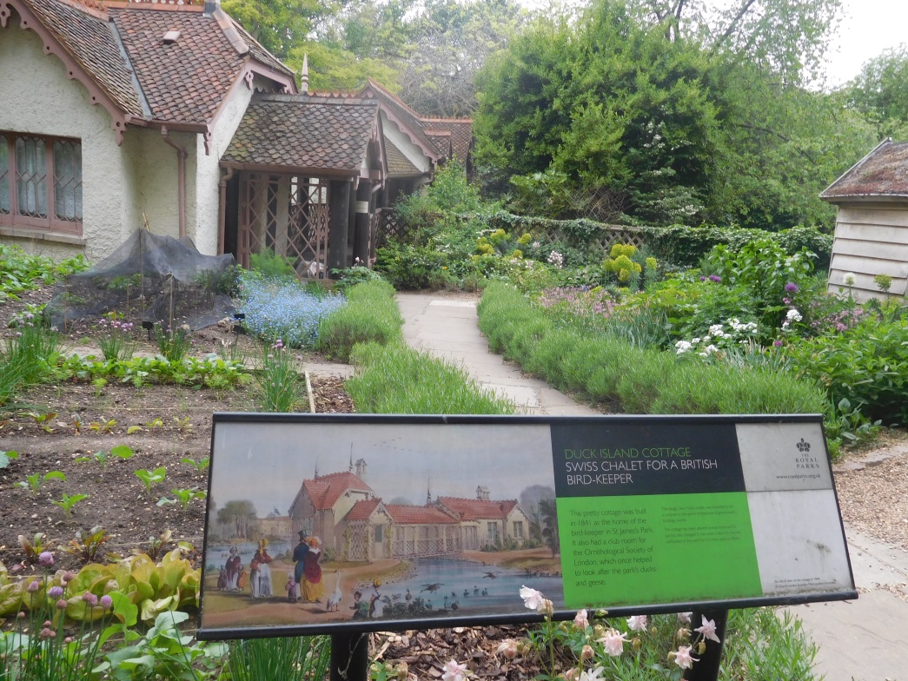
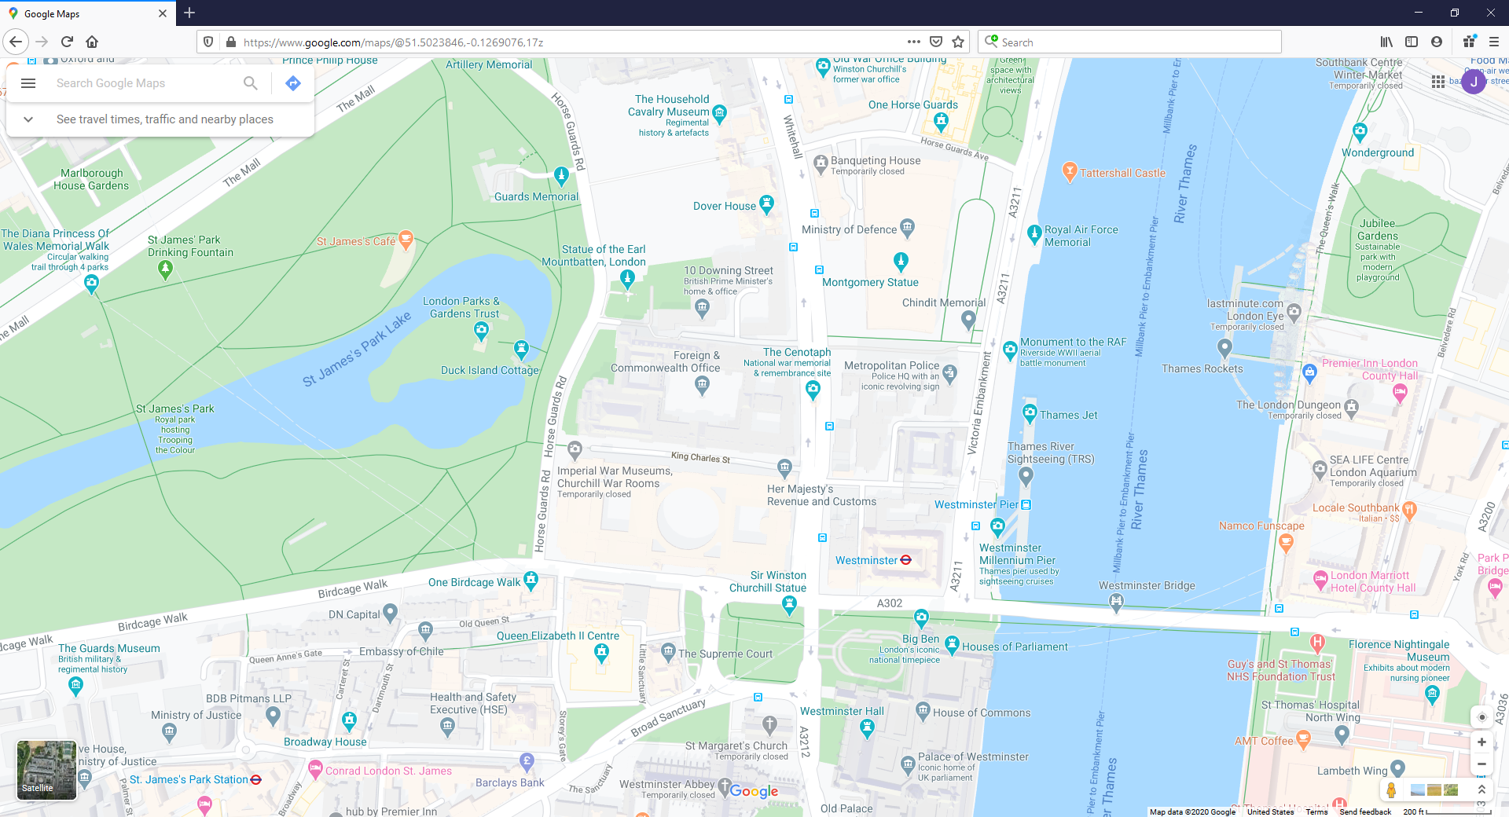
Duck Island Cottage
Notes:
As we walked, we came to Duck Island Cottage which has served as the offices of the London Historic Parks and Gardens Trust since 1994. A cottage garden in Arts and Crafts style is there now.
Birds of various kinds have been kept in this place since 1612, when James I began converting the swampy hunting park of the Tudor monarchs into a formal garden. Charles II created the post of ‘Governor of Duck Island’ and William II had the first lodge build. It was destroyed in 1771 and rebuilt in 1840, as a picturesque cottage designed by John Burges Watson. In 1953 it was nearly demolished but, instead, was noticed by Royal Fine Art Commission and preserved as a keeper's cottage.
https://www.londongardenstrust.org/features/dicframe.htm
https://www.gardenvisit.com/gardens/duck_island_cottage_garden

Slide 11
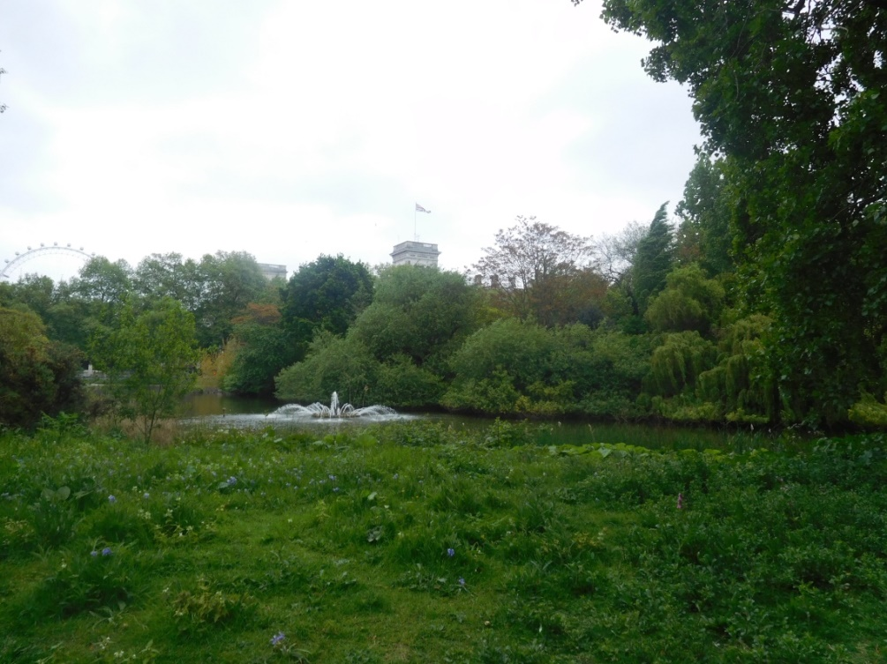
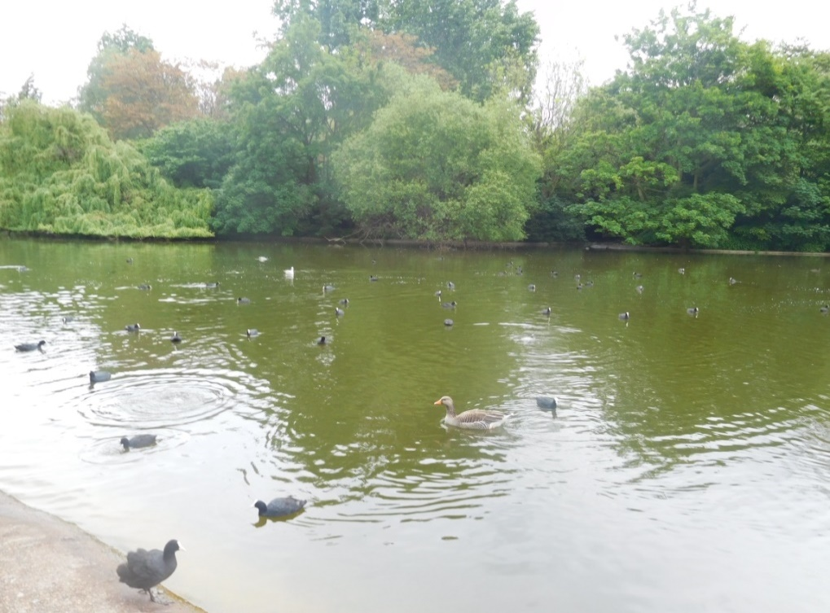
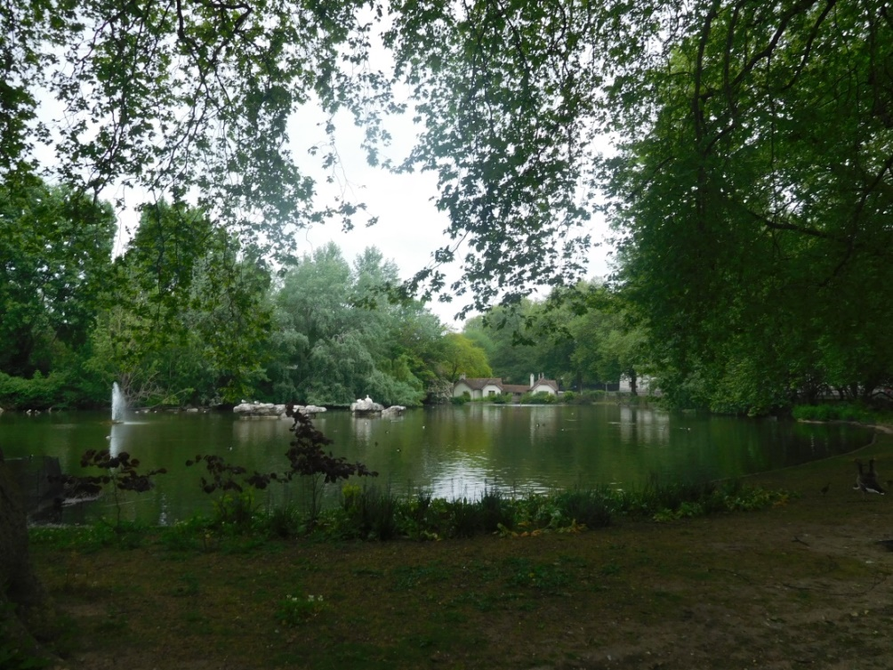
Notes:
We could see the Buckingham Palace and the London Eye on hour walk through St James Park.
St James’s Park is a 57-acre park names after a leper hospital dedicated to St James the Less.
https://en.wikipedia.org/wiki/St_James%27s_Park

Slide 12
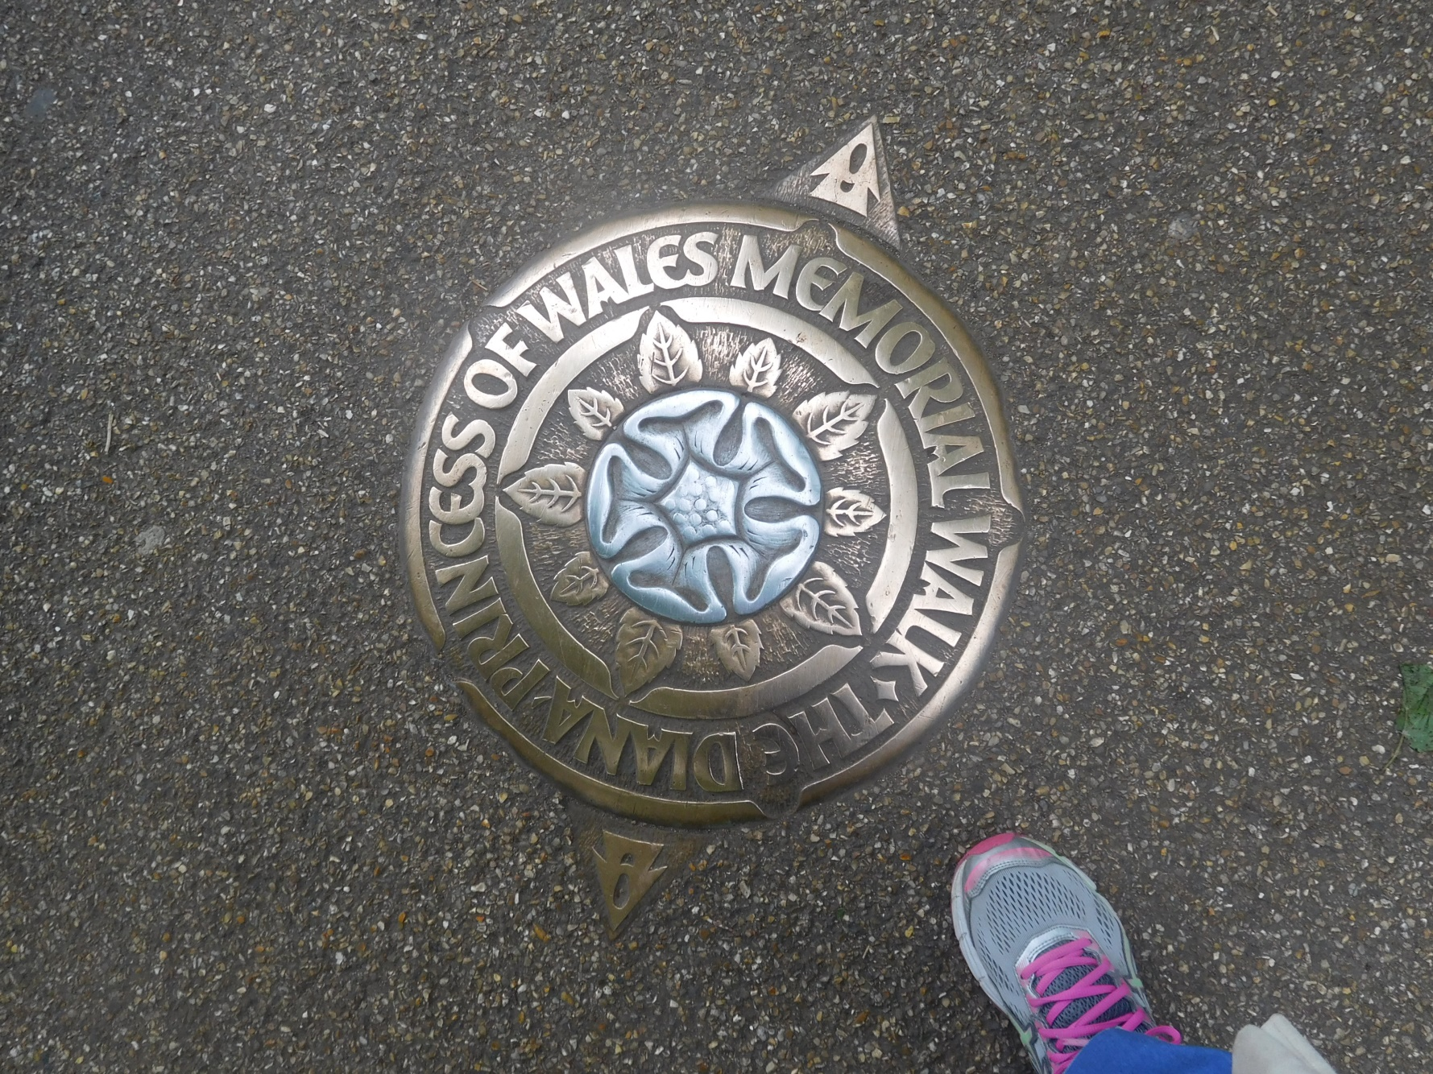
Notes:
We were on the Diana Princess of Wales Memorial Walk part of the way. It is a seven-mile-long walk with 90 plaques set in the ground that takes you within sight of famous buildings and locations associated with the Princess during her life: four Royal Parks, three palaces and two mansions.
“The plaques are the work of Alec Peever. They have a rose emblem at the center and are etched in aluminum. The rose is heraldic in design, and while symbolizing the Princess’s enduring image, also symbolizes Britain’s traditions and heritage.”
https://www.royalparks.org.uk/parks/hyde-park/things-to-see-and-do/sports-and-leisure/the-diana-princess-of-wales-memorial-walk

Slide 13
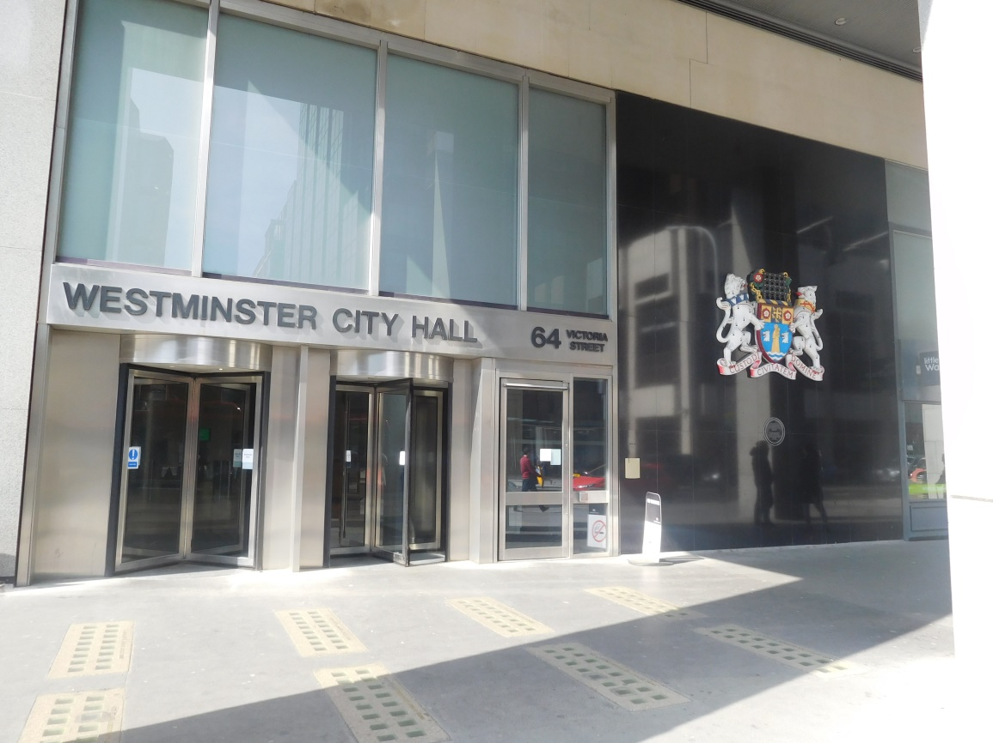
Westminster City Hall
Notes:
On our way back to the hotel on the first day, we passed the Westminster City Hall. This is the entrance on Victoria Street.

Slide 14
Christchurch Gardens
Notes:
Next we passed a little park that had a lot of birds. Because it was close to our hotel we went past many times and it always had a great number of birds in it.
The history was also interesting as explained on the sign.
http://www.londongardensonline.org.uk/gardens-online-record.php?ID=WST018

Slide 15
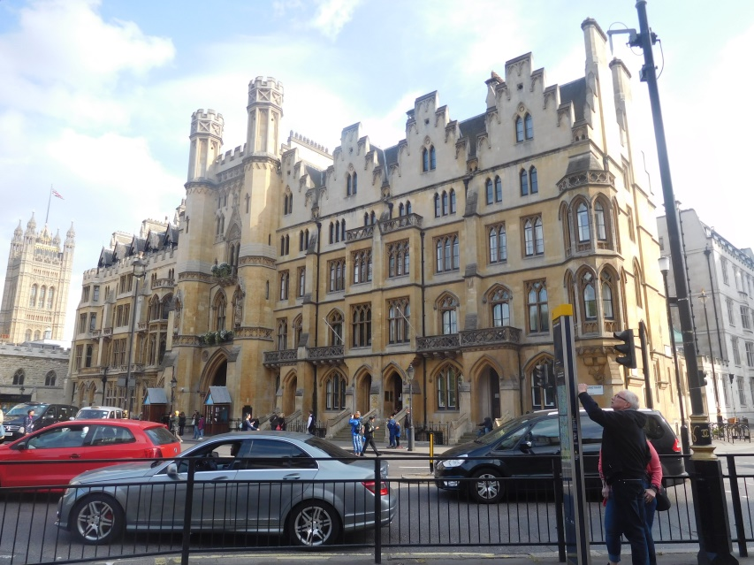
Westminster Abbey
Notes:
Because our hotel was so close to Westminster Abbey, we also walked past it on many days.
Westminster Abbey, neither a cathedral nor a parish church but a Royal Peculiar, has been the site of every Coronation since 1066 and other royal occasions, including sixteen royal weddings. Today it is still a church dedicated to regular worship and to celebration of great events in the life of the nation.
https://www.westminster-abbey.org/about-the-abbey/history/history-of-westminster-abbey

Slide 16
Big Ben
Notes:
Big Ben is the nickname for the Great Bell of the striking clock at the north end of the Houses of Parliament. It is usually extended to refer to both the clock and the clock tower. The official name of the tower in which Big Ben is located was originally the Clock Tower but it was renamed Elizabeth Tower in 2012 to mark the Diamond Jubilee for Elizabeth II. Big Ben is the largest of the tower’s five bells and weighs 13 tones. The tower stands 315 feet tall.
https://en.wikipedia.org/wiki/Big_Ben
https://www.visitlondon.com/things-to-do/sightseeing/london-attraction/big-ben

Slide 17
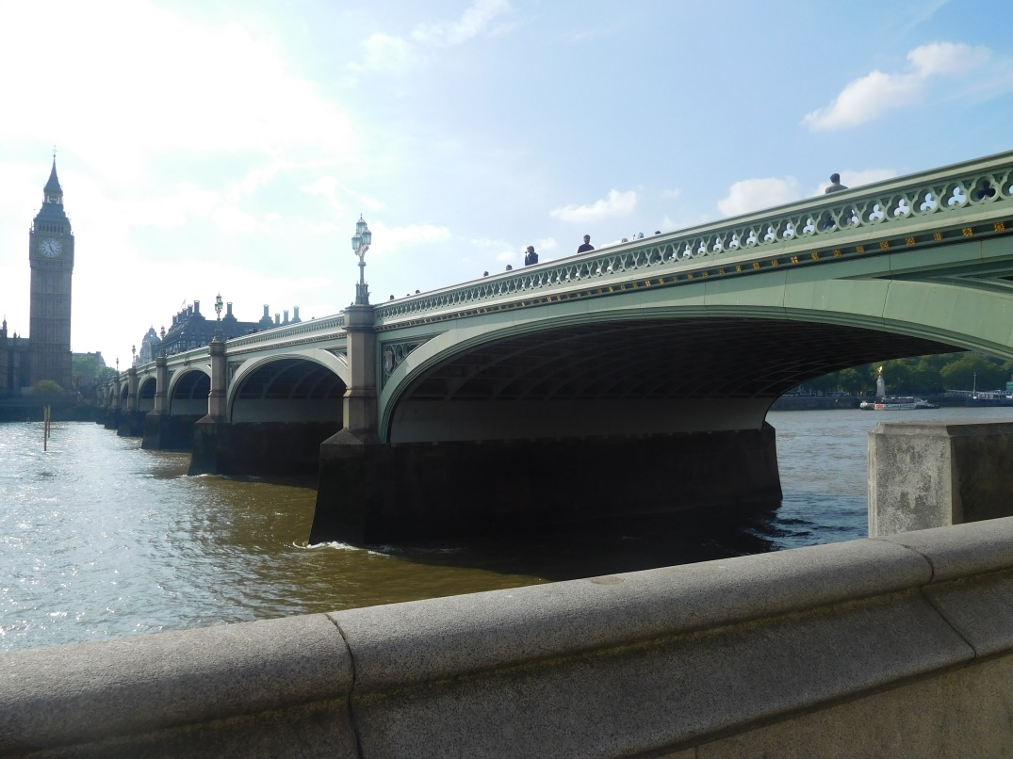
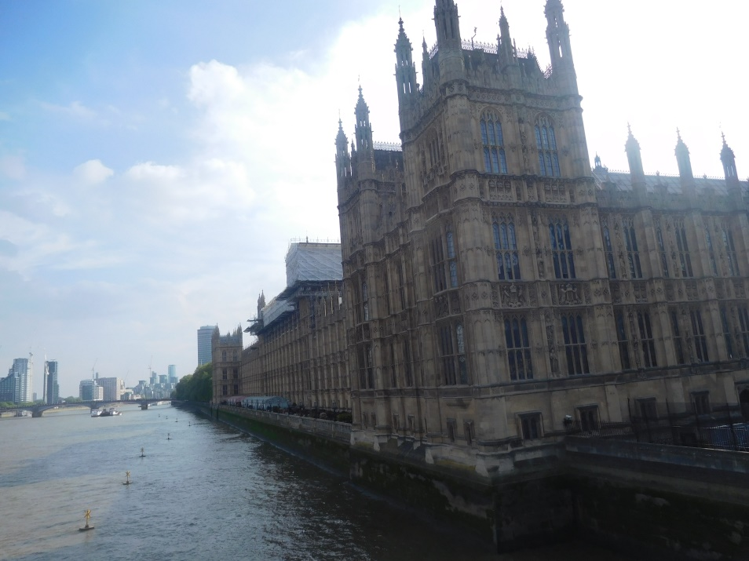
Westminster Bridge
Notes:
From Westminster Abbey, we walked past the Houses of Parliament and onto the Westminster Bridge. From it we could see the Houses of Parliament on the Thames River and the London Eye on the other side.

Slide 18
The Queen’s Walk
Notes:
We enjoyed the entertainers on The Queen’s Walk on our way to the Golden Jubilee Bridges.

Slide 19
The Golden Jubilee Bridges

Slide 20
Trafalgar Square
Notes:
We walked to Trafalgar Square, a public square in the City of Westminster built around the area formerly known as Charing Cross.

Slide 21
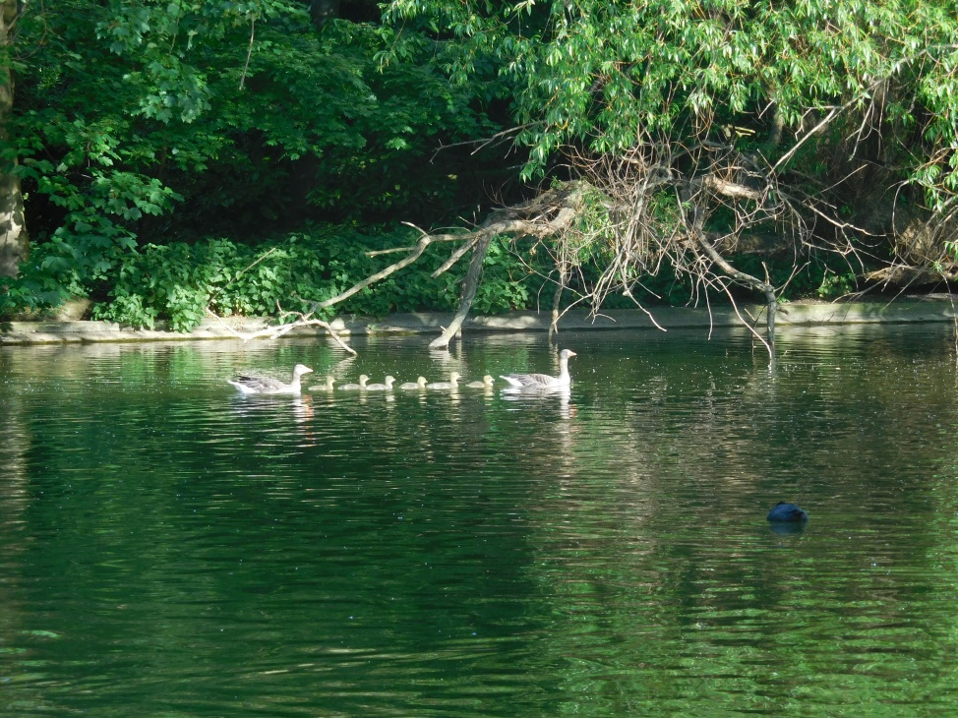
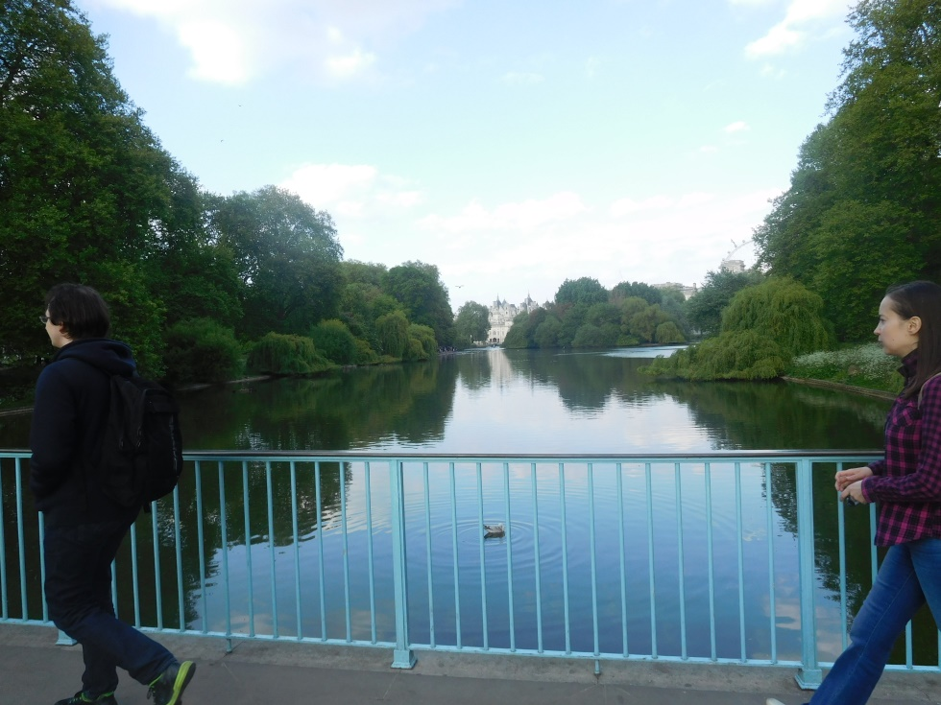
Blue Bridge in St James Park
Notes:
We then were back at Horse Guards and St James Park.

Slide 22
Playground in St. James’s Park
Notes:
Before going back to the hotel, we stopped at a playground in St. James’s Park that has swings, a sandbox with big rocks to climb on and a pulley system for moving sand, bridges, slides, climbing ropes, a spider to crawl on, and even more fun equipment.

